Slide 1
Election Update
Presidential Primary 2024
Charter Township of Bloomfield

Slide 2
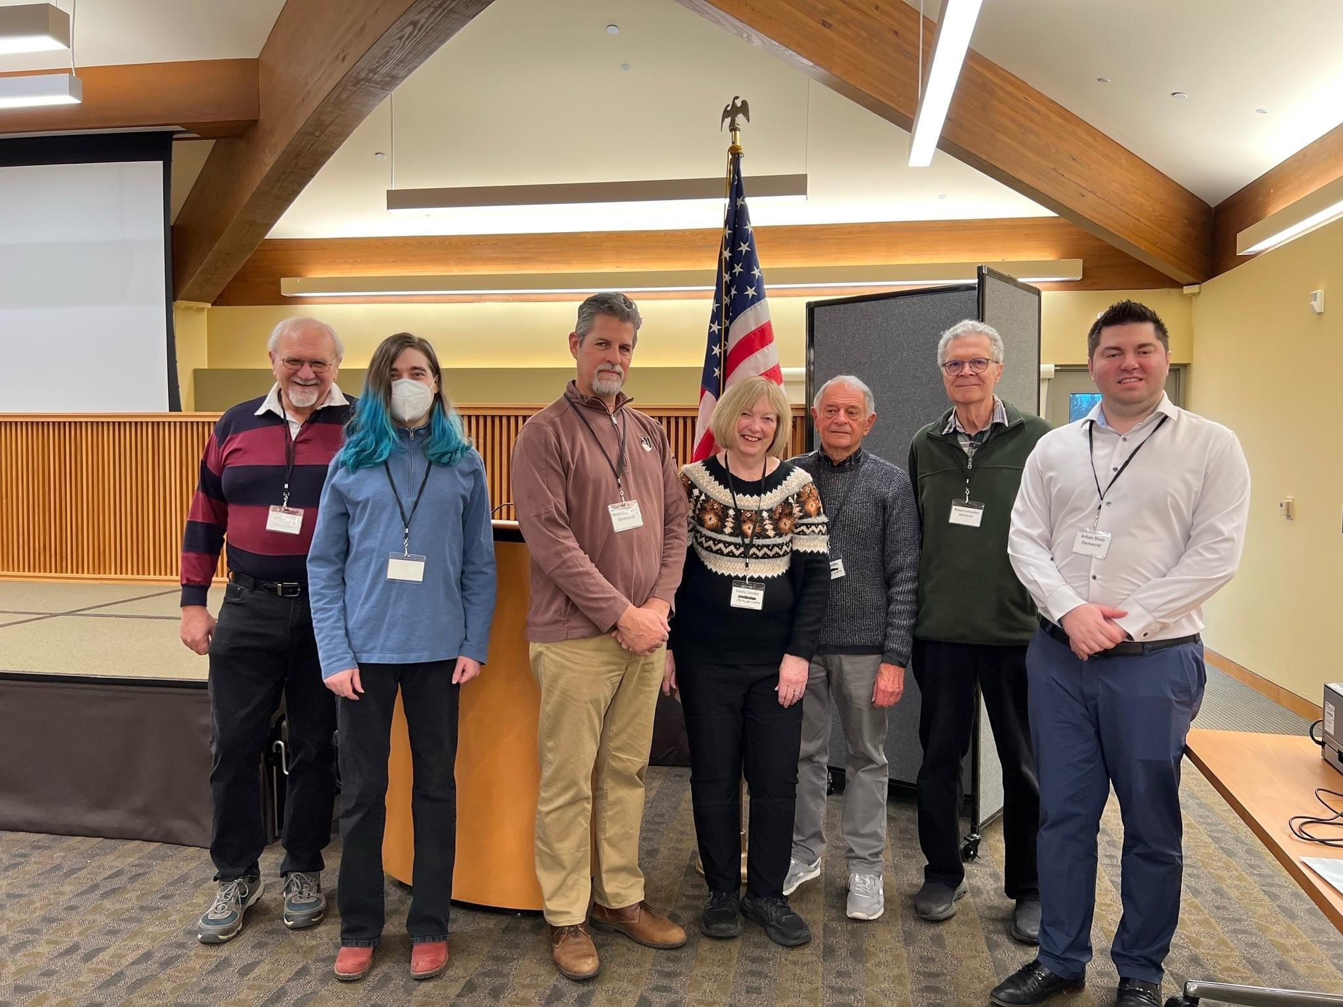
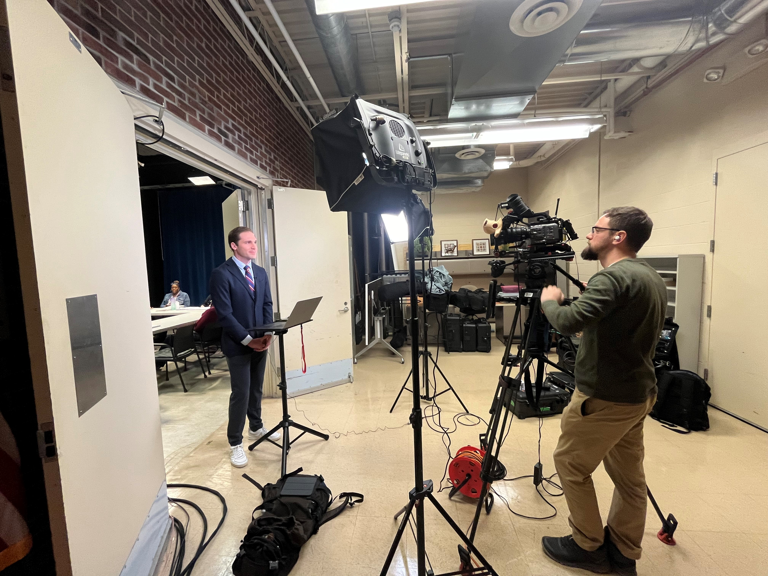
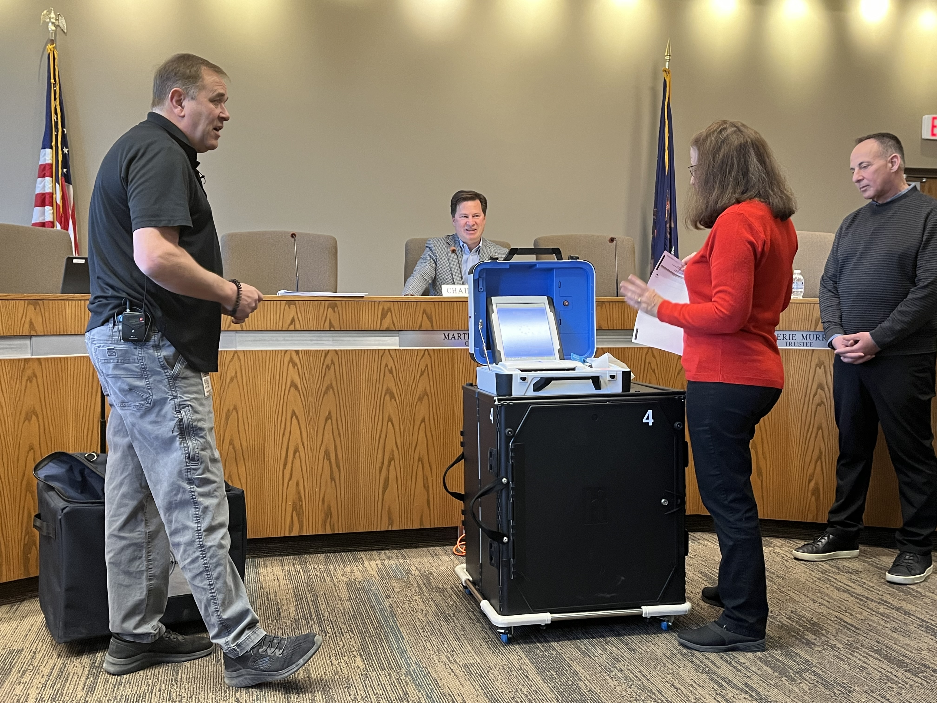
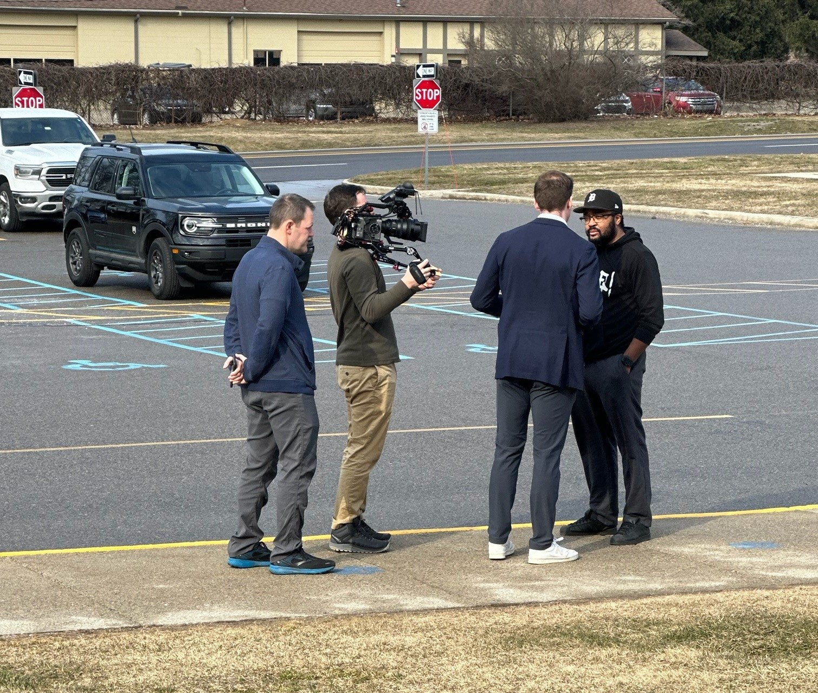
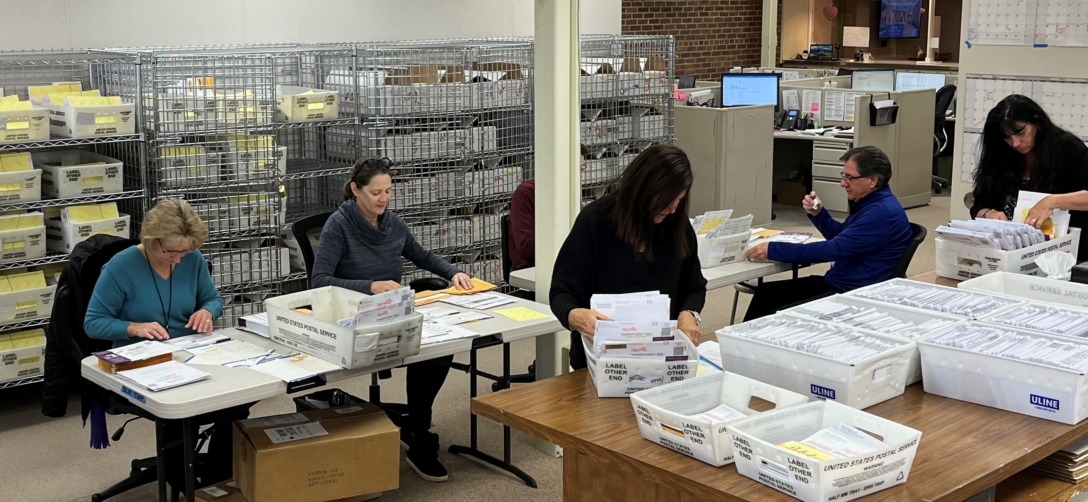
Elections People & News

Slide 3
Election Turnout
Number of Voters
2012 11,093
16,955
2020 17683
2024 13286

Slide 4
Library Millage Renewal – The Results

Slide 5
Election Procedures – Highlights for 2023-24
Presidential Primary Date Changed
Permanent Mail Ballot List Built
Early Voting Implemented
Absentee Voting in Precincts allowed
Military of Overseas Voting Deadline Extended to Monday after Election Day
Absentee Voter Signature Cure Deadline Moved to 5pm Friday after Election Day
Early Absentee Ballot Processing Expanded

