Slide 1

2024 General Election
Bloomfield Township Clerk’s Office

Slide 2
The Team, The Team, The Team.
Election Staff for the 2024 Election Cycle
Clerk’s Office:
Equipment Team:
Dave Crouch
Chris Whitehead
Mike Cummings
AV Processing Team:
12 Workers
Martin Brook Deana Mondock
Diane Perkins
Catarina Yankey
Thomas Hayes
Sean Mueller
Justin Fortney
Receiving Board:
13 Workers
Precinct Team:
225 Chairpersons/
Inspectors
AV Counting Board:
75 Chairs/Inspectors
All Other Township Departments

Slide 3
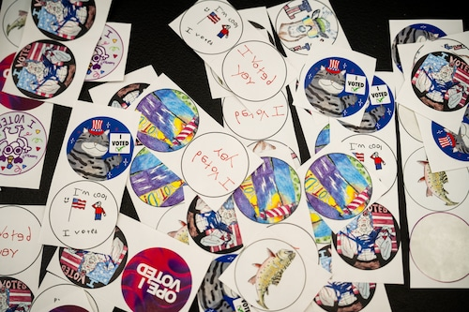
Voter Turnout
38,587 registered voters in Bloomfield Township
30,750 ballots cast
79.69% turnout

Slide 4
Historical Election Turnout
Year: | Voter Turnout:
2012 | 79.96%
2014 | 62.03%
2016 | 77.85%
2018 | 64.53%
2020 | 80.97%
2022 | 67.42%
2024 | 79.69%

Slide 5
Voter Turnout Compared to Oakland County
14th highest voter turnout in Oakland County out of 130 municipalities.

Slide 6
Early Voting
Oct. 26th – Nov. 3rd
Bloomfield Township Library
Waterford Oaks Activity Center
Opportunities for improvement

Slide 7
Voter Turnout By Precinct
Highest turnout: Precinct 7
82.88%
Lowest turnout: Precinct 1
73.25%
Highest

Slide 8
Demographics
 | 18-21: | 22-30: | 31-40: | 41-50: | 51-59: | 60+: | Totals:
Male: | 859 | 1545 | 1584 | 2218 | 2262 | 6109 | 14577
Female: | 863 | 1574 | 1862 | 2474 | 2517 | 6870 | 16160
Totals: | 1722 | 3119 | 3446 | 4692 | 4779 | 12979 | 30737

Slide 9
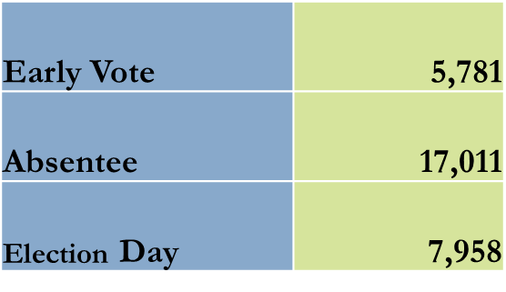
Voting Method
(EV)

Slide 10
Absentee Ballot Return Method
Lobby Safe: 4,569
Post Office: 4,289
Clerk’s Counter: 3,475
Town Hall Drop Box: 2,323
Village Drop Box: 1,035
West View Drop Box: 775

Slide 11
Voting Method
2016
2020
2024
*EV= Early Voting

Slide 12

Thank You!

