Slide 1

August 6th Primary Election Update

Slide 2
The Team, the team, the team.
Equipment Team:
Dave Crouch
Chris Whitehead
Mike Cummings
Clerk’s Office:
AV Processing Team:
10 Workers
Martin Brook Deana Mondock
Diane Perkins
Catarina Yankey
Thomas Hayes
Sean Mueller
Justin Fortney
Receiving Board:
13 Workers
Precinct Team:
225 Chairpersons/Inspectors
AV Counting Board: 75 Chairs/Inspectors
Support from throughout the various Township Departments

Slide 3
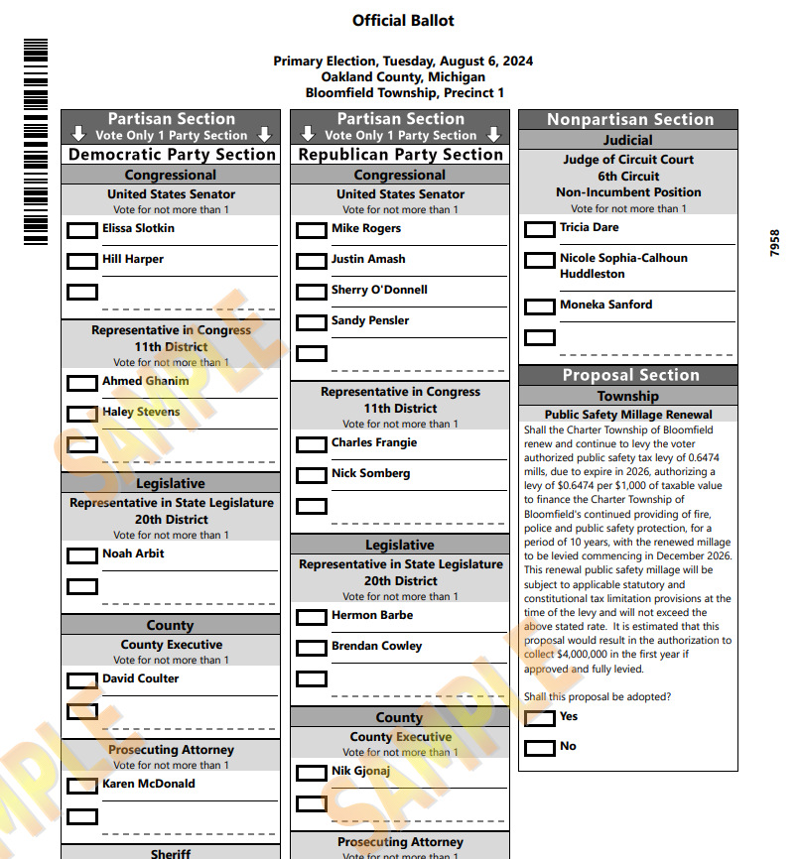
Primary Election
Total Ballots Cast: 12,131
This election determined who will be on the ballot in November
Voters had to stay in one lane on the ballot

Slide 4
Turnout
31.6% Voter Turnout

Slide 5
Turnout by precinct

Slide 6
Method of voting

Slide 7
Absentee Ballots - Method of Return

Slide 8

General Election
Key Dates:
  Sept. 18 – Election Commission Meeting
  Sept. 21 – AV Ballot delivery deadline
  Sept. 26 – AV Mailing Deadline
  Oct. 13 – Tom Hayes is running in the Chicago Marathon
  Oct. 15 – Election Commission/Public Accuracy Test
  Oct. 26 – Early Voting Starts at Bloomfield Twp. Library
  Nov. 5 – Election Day

Slide 9
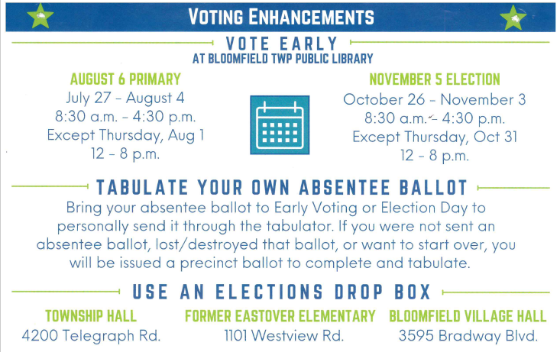

Slide 10
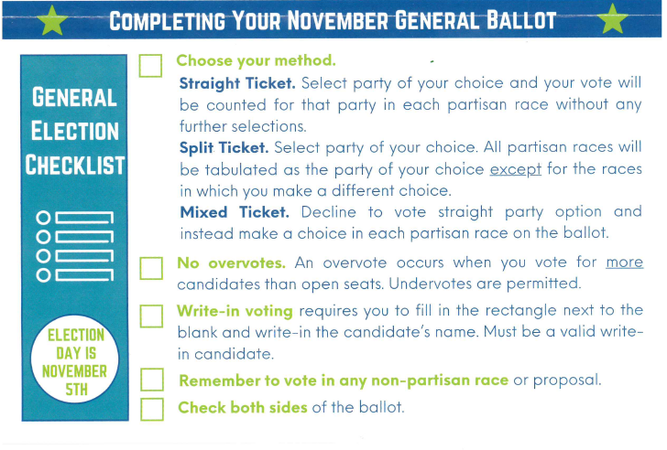

Slide 11
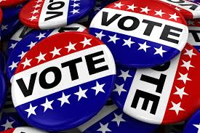
Questions?

